Slide 1
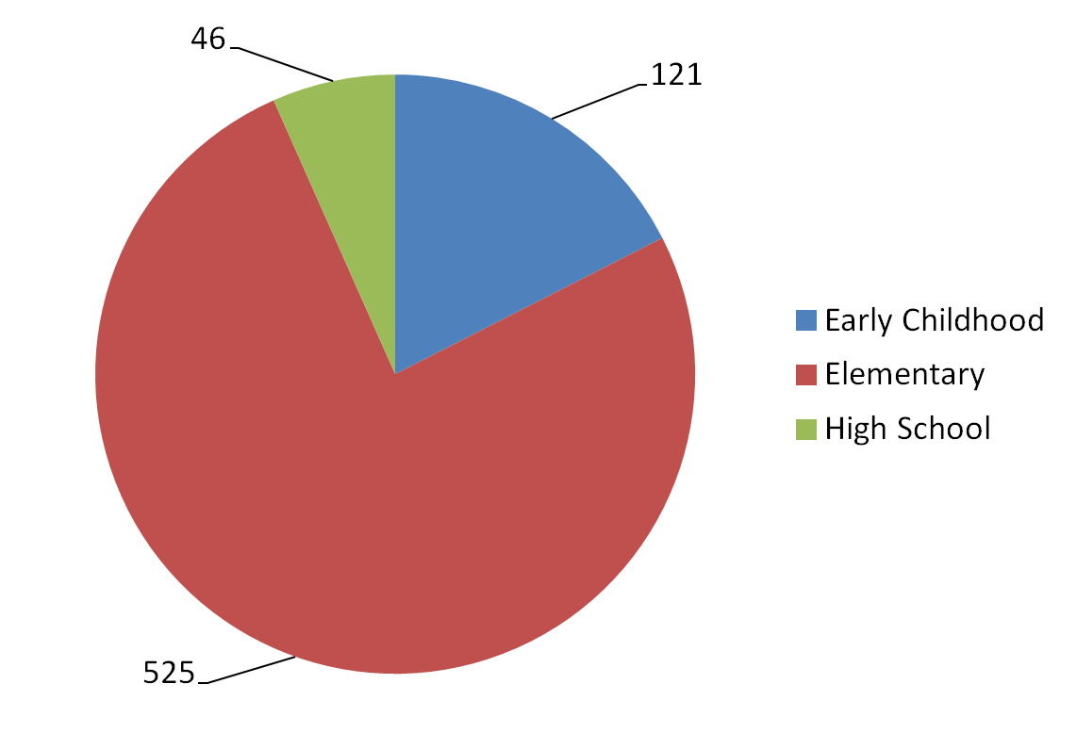
Accredited Schools By Type
Total: 692

Slide 2
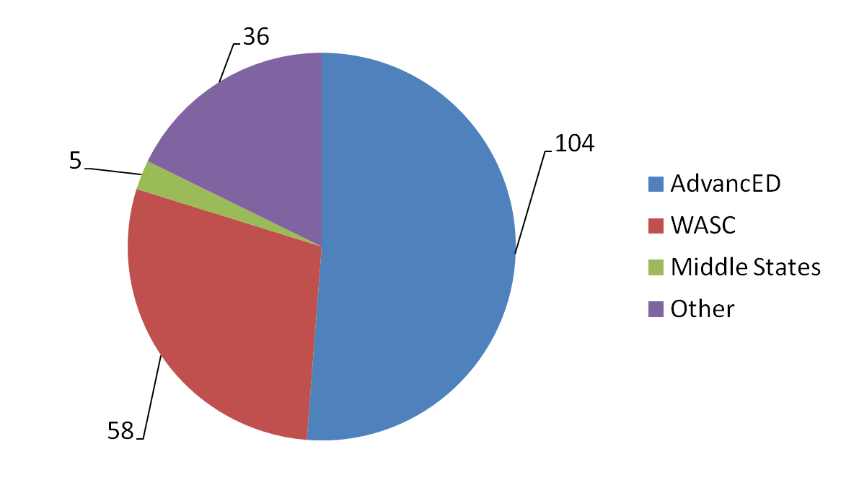
Distribution of Co-Accredited Schools
Total: 203

Slide 3
2016 Candidate Schools by Type of School
125 Candidates
24 Early Childhood Centers
92 Elementary Schools
9 High Schools

Slide 4
2016 Candidate Schools by Protocol used
77 Evidence Based Accreditation
14 Dual Accredited AdvancED
9 Dual Accredited WASC
1 Dual Accreditation CCLE
1 Standards Based Accreditation
23 Early Childhood

Slide 5
Extensions
62 Granted in 2014/2015
37 Granted in 2015/2016

Slide 6
EBA Results
2015 69 schools | 2016 73 schools
3.01 average | 2.92 average
16 above average 53 below average | 33 above average 40 below average
10 schools higher than 3.5 | 2 schools higher than 3.5

Slide 7
Level and Award Changes Effective with 2017 Candidates
What is a candidate school?
Accredited in Good Standing
Accredited with Provision
Accredited with Distinction

Slide 8
Accredited In Good Standing
A school successfully concludes an NLSA process or completes a process associated with recognized accreditation partners, complies with required standards and indicators of success, and is committed to continuing school improvement.
THIS IS A SIGNIFICANT ACCOMPLISHMENT!

Slide 9
Accredited with Provision
An accredited school concludes an NLSA process or completes a process associated with recognized accreditation partners. The school has failed to comply with any single required evidence or indicator, or has major deficiencies, but demonstrates a commitment to continuing school improvement.
A school using the EBA protocol that is assigned any general indicator rating of “1” results in the automatic designation of Accreditation with Provision.

Slide 10
MAJOR DEFICIENCY:
Any condition that is based on an NLSA standard which has a severe negative effect on the quality of education, the ministry of the school, and/or endangers the health or safety of the school population. The deficiency must be remedied by the school within the time parameters (no longer than 2 years) prescribed by the visiting team and approved by the NAC.

Slide 11
Accredited with Distinction
Accreditation with Distinction may be awarded to schools with overall school accreditation averages that fall within the top 5 percent of the group of schools that were accredited within the year.

Slide 12
A Powerful Practice is much more than an expectation that quantifies standard compliance. It innovates and exceeds accreditation expectations. It is an uncommon, calculated risk that has resulted in significant reward for the students. Therefore it is a desirable condition that has ramifications for our schools within the LCMS alliance.

Slide 13
Powerful Practices dramatically improve the overall quality of education provided to students by the school or significantly enhance ministry opportunities that are available to the school and its congregation(s).

Slide 14
Powerful Practices drive innovation and
systemic change.
Powerful Practices need not be associated with Schools of Distinction

