Slide 1
NLSA Organization of Your Google Document and Make a Website
Presented by: Deb Volberding Friday, September 14, 2018
deb.volberding@stjlutherean.org
Notes:
Deb: Open your accreditation drive in a second tab.

Slide 2
#1
Download the NLSA Document from the MN South District Website and upload it to you Google Drive.
Minnesota NLSA Website
http://www.minnesotanlsa.org/
EBA (Evidence Based Accretation) Self-Study

Slide 3
#2
Watch the Videos Provided on the website
Video Launch Page
http://www.minnesotanlsa.org/instruction-videos.html
Videos for:
School Coordinator
Building your Self Study Document in Google Docs.
Other videos for team captains, consulants and team members

Slide 4
#3
Prepare Your Document in Google
Choices:
Make a NLSA (2018) Folder in a google account. (video)
Make a new google drive for your accreditation within your Google Classroom Accounts. We named ours Accrediation@stjlutheranschool.org. It has its own email, so documents don’t have to be “shared” into the folder. It beame our offical file cabinet for all accreditation evidence.

Slide 5
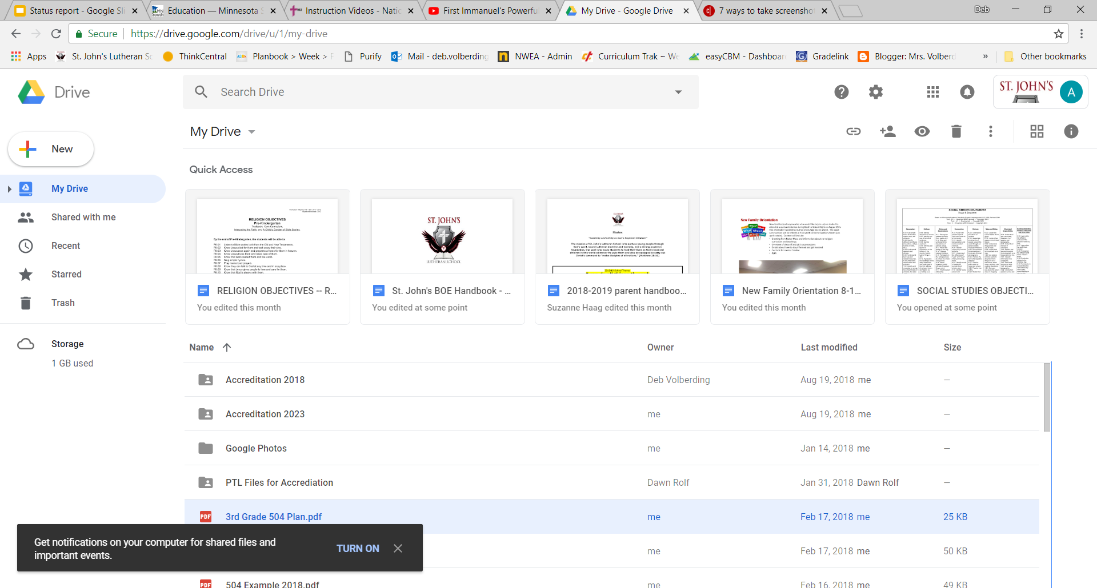
Example of the Accreditation Google Drive and some folders.

Slide 6
#3 (continued)
Prepare Your Document in Google Documents
Change the little check off boxes to something that is easier to manage.
We used [ ] brackets.
Then added a capital X
[X]
Our editors did this for the whole document in all sections.

Slide 7
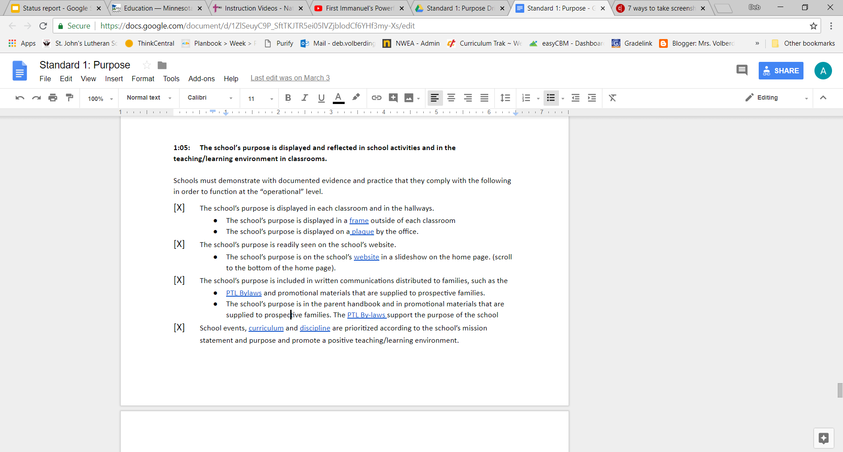

Slide 8
#4
Break the document into 8 parts.
Copy and paste into a new document each of the 8 parts and put that document into its own folder.
General Information
Standard 1: Purpose Driven
Standard 2: Relationships
Standard 3: Leadership
Standard 4: Professional Personal
Standard 5: Teaching and Learning
Standard 6: Student Services
Standard 7: Facilities

Slide 9
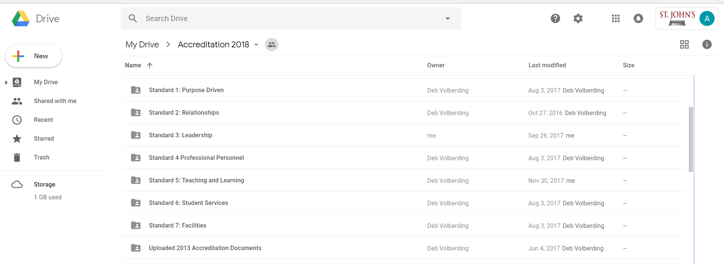
Note: Make sure you start your work in this drive so the owner is “Accreditation” and not shared into the document!

Slide 10
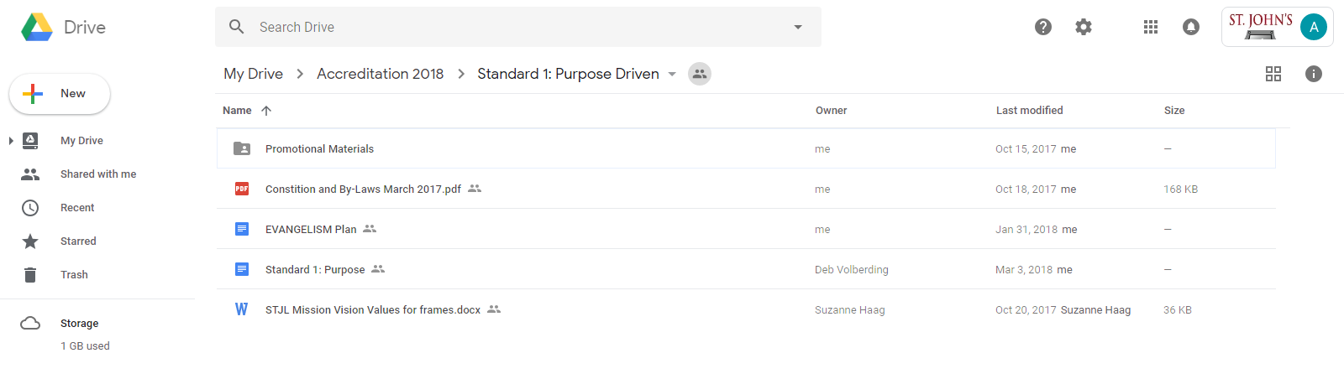
Pro. Mat
C &BL
E Plan
Purpose
Mission

Slide 11
#5
Start answering questions, writing statements and linking evidence.
Work in teams for each standard.
Start collecting and uploading evidence into your folders.
Scan and email evidence to your Accrediation account or share it to that file.
Example:
Go to mail to find evidence
Hover, click on it and save it to drive.
Make photo albums , audios and videos to link also.

Slide 12
#6
Make it easy for the team members to view!
Optional: Build an Accreditation Website using Google Sites and attach each of your pages to a new tab.
Our site https://sites.google.com/site/stjohnsaccreditation/

Slide 13
Let’s Build a Site!

Slide 14
Thank You!

